Slide 1
Project Development Design Review
By Connor Bivens

Slide 2
Purpose of Software
The program is meant to allow a customer to view a menu of ten items, select one to purchase, choose how many of said item they wish to purchase, and then loop until they are ready to finish. Then they enter an input to get the total number of each type of item as well as the total cost of everything plus sales tax.

Slide 3
My Process
I swapped the if/else if statements from the original menu program with a switch statement. I also managed to put most of the interior of my main function inside of a function itself, which saved a lot of space. Inside of this function I added the additional capability of calculating a total cost of the entire order, including sales tax. I also made the printing of the menu into a function as well.

Slide 4
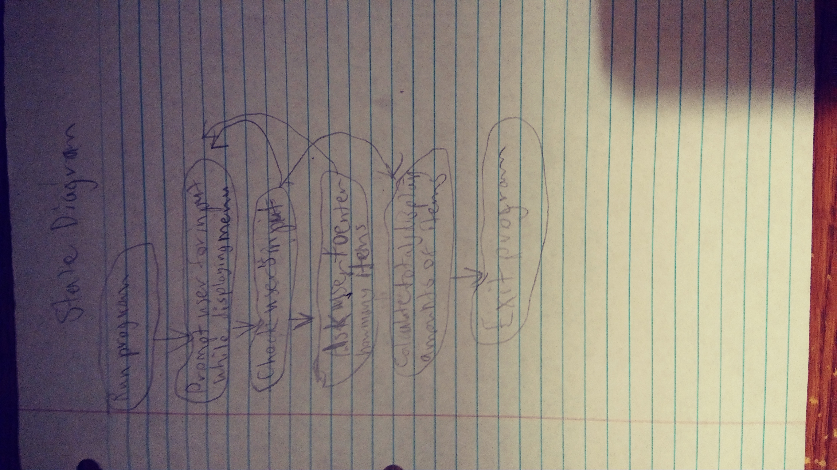
State Diagram

